Slide 1

10th Iran Internet
Contest
Solution Sketches

Slide 2
Statistics (Submission to Solve)

Slide 3
Statistics (Fastest to Average)

Slide 4
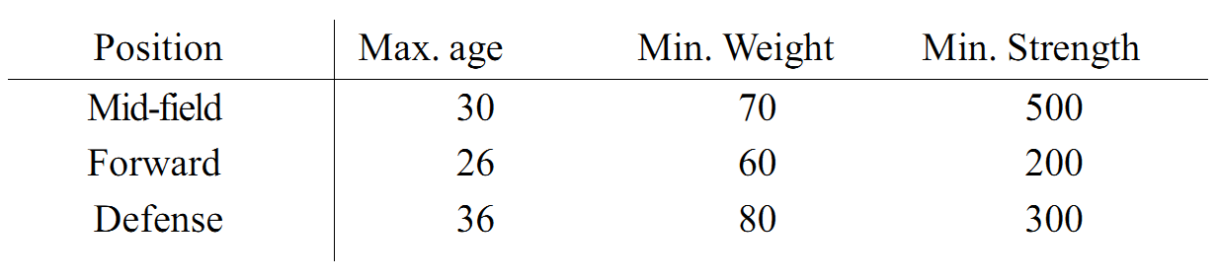
Problem A: Setting up a Football Team
113 correct solutions (best 5)
For each student and each position, check the constraints and output accordingly!

Slide 5

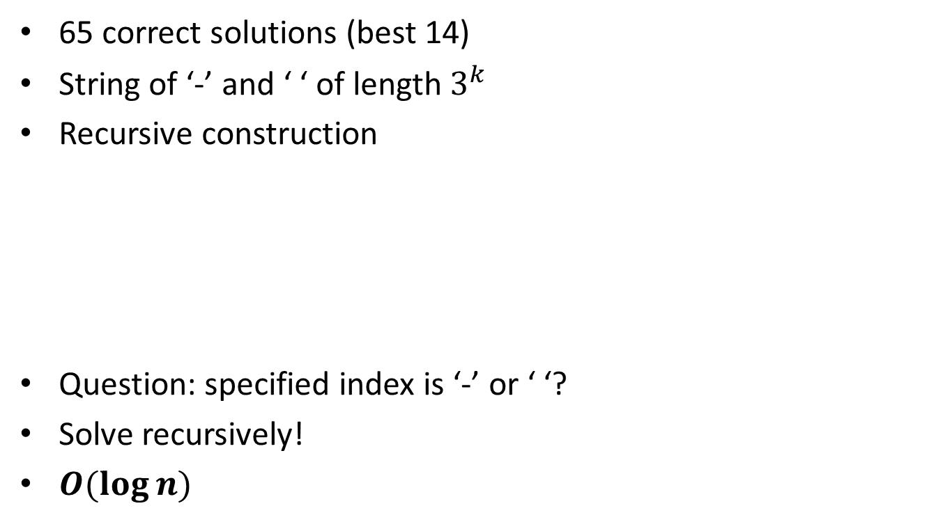
Problem B: Fractals
65 correct solutions (best 14)
String of ‘-’ and ‘ ‘ of length $3^{k}$
Recursive construction
Question: specified index is ‘-’ or ‘ ‘?
Solve recursively!
$O(\log{n)}$

Slide 6
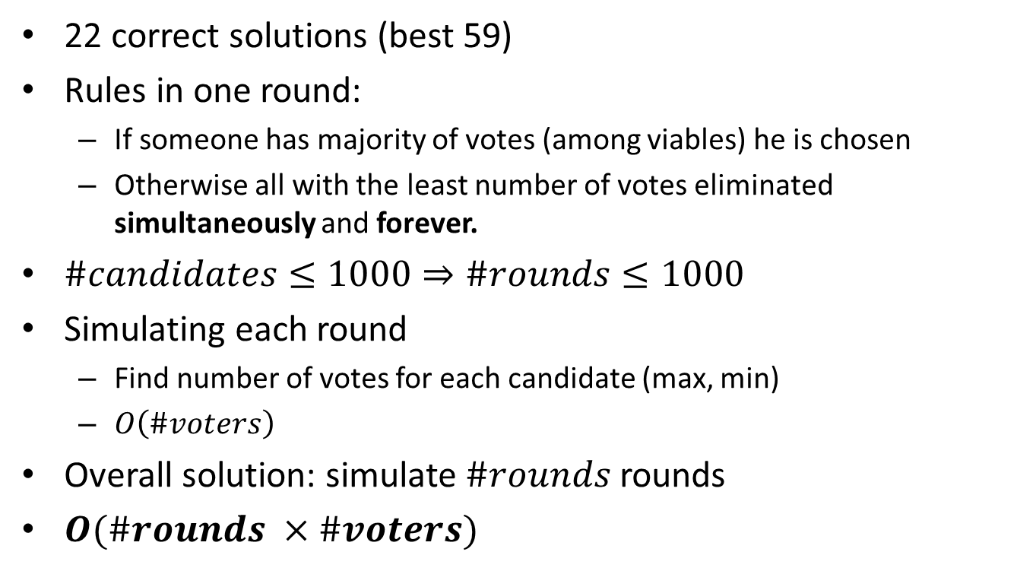
Problem G: Electing SSC Chair
22 correct solutions (best 59)
Rules in one round:
  If someone has majority of votes (among viables) he is chosen
  Otherwise all with the least number of votes eliminated simultaneously and forever.
$\#candidates≤1000⇒\#rounds≤1000$
Simulating each round
  Find number of votes for each candidate (max, min)
  $O\left(\#voters\right)$
Overall solution: simulate $\#rounds$ rounds
$O(\#rounds ×\#voters)$

Slide 7


Problem H: Mastermind
21 correct solutions (best 32)
Code-maker chooses code:
  N number in range [1, k]
Code-breaker makes some guesses:
  Similar to code
  Code-maker gives a hint:
    Black points: correctly guessed slots
    White points: correct number is different slots

Slide 8
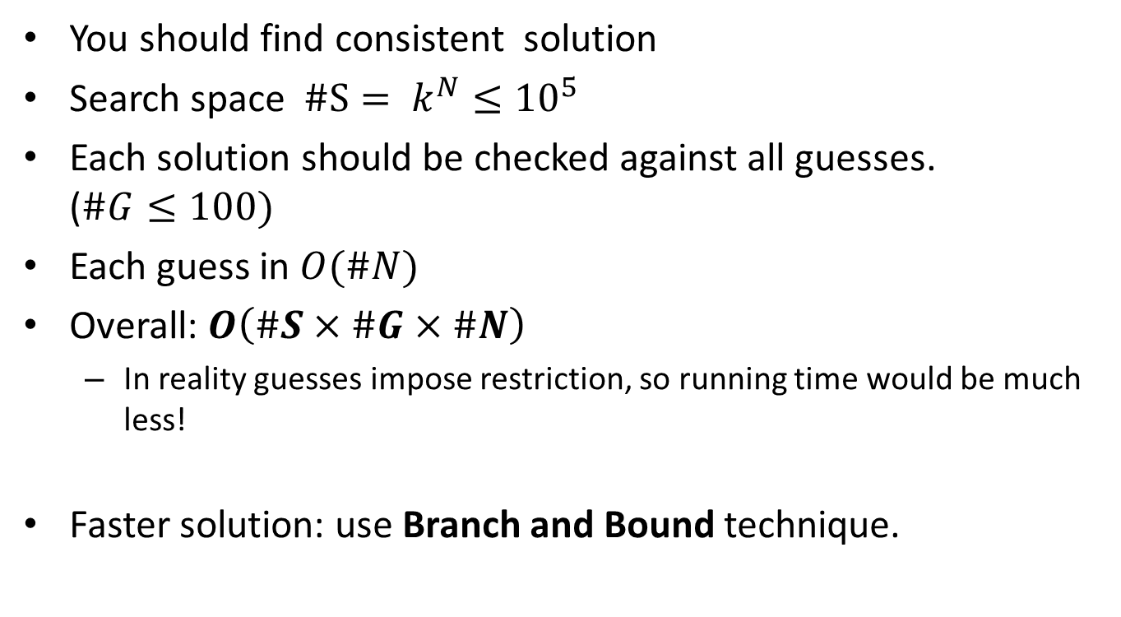
Problem H: Mastermind
You should find consistent solution
Search space $\#S= k^{N}≤{10}^{5}$
Each solution should be checked against all guesses. ($\#G≤100)$
Each guess in $O(\#N)$
Overall: $O\left(\#S×\#G×\#N\right)$
  In reality guesses impose restriction, so running time would be much less!
Faster solution: use Branch and Bound technique.

Slide 9
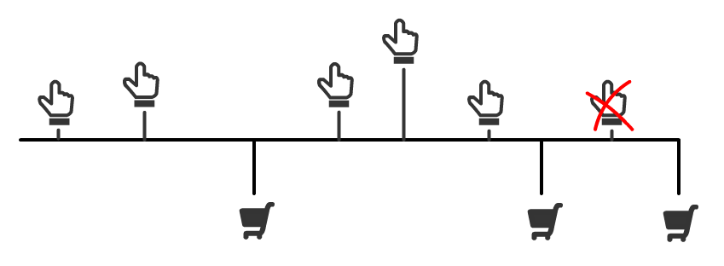
Problem F: Auctions
16 correct solutions (best 121)
k items to be sold
m bidders
n bids on items

Slide 10
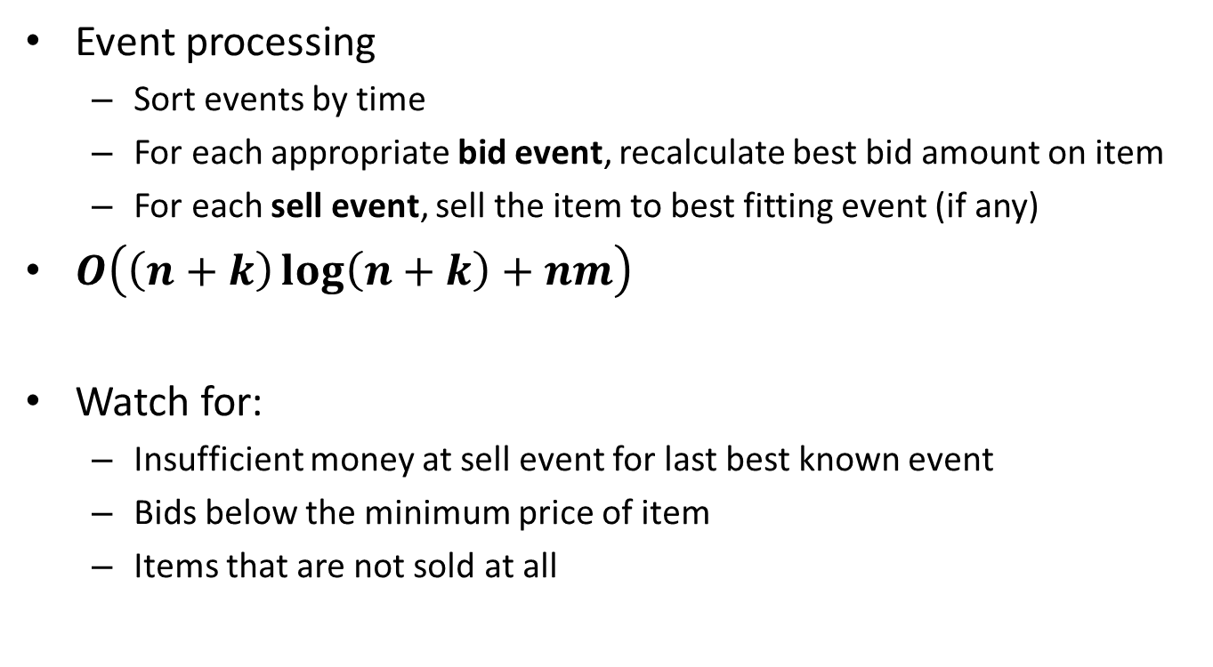
Problem F: Auctions
Event processing
  Sort events by time
  For each appropriate bid event, recalculate best bid amount on item
  For each sell event, sell the item to best fitting event (if any)
$O\left(\left(n+k\right)\log\left(n+k\right)+nm\right)$
Watch for:
  Insufficient money at sell event for last best known event
  Bids below the minimum price of item
  Items that are not sold at all

Slide 11
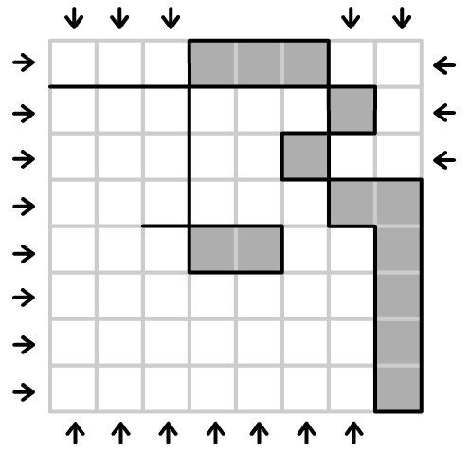
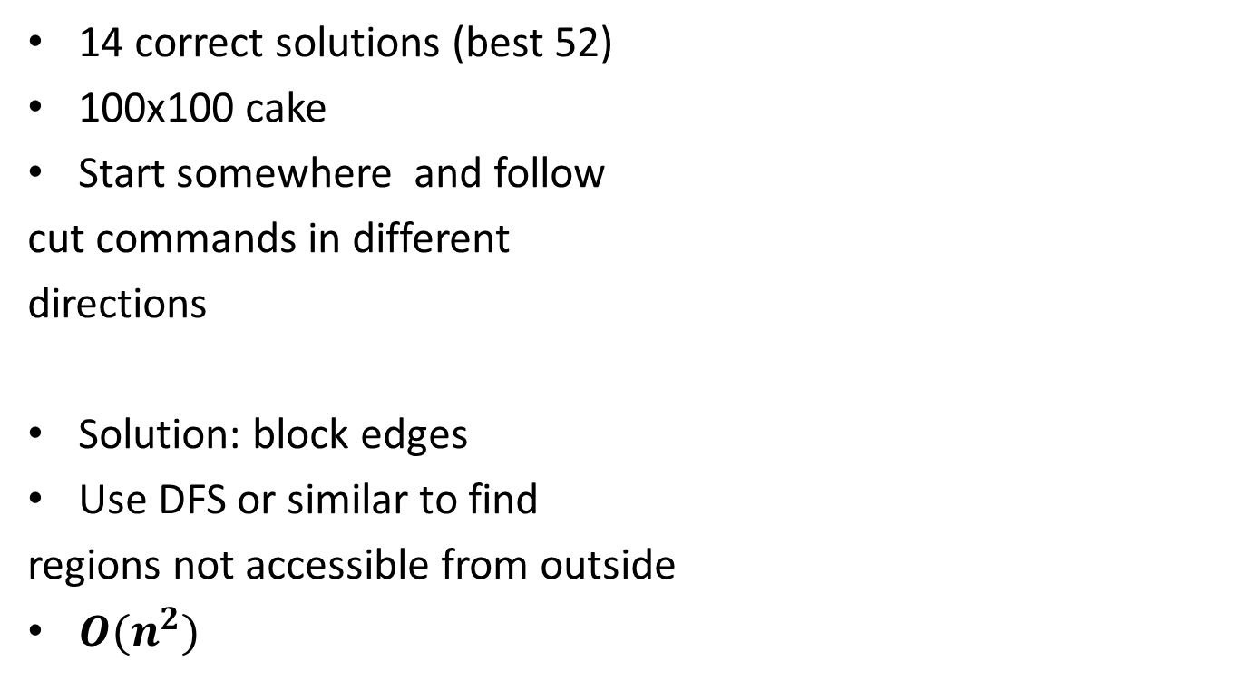
Problem C: Cutting a Cake
14 correct solutions (best 52)
100x100 cake
Start somewhere and follow
cut commands in different
directions
Solution: block edges
Use DFS or similar to find
regions not accessible from outside
$O(n^{2})$

Slide 12
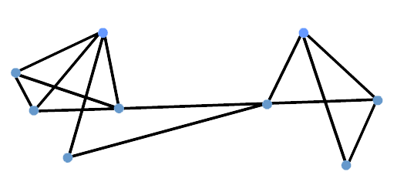
Problem E: Hubs
3 correct solutions (best 171)
n vertices are divided into two groups
Each group has a representative
H1
H2
B
A

Slide 13
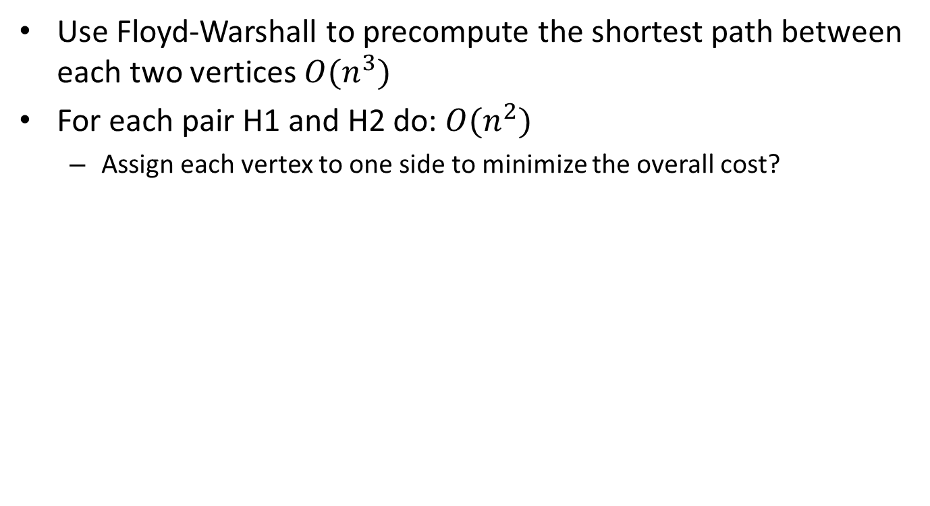
Problem E: Hubs
Use Floyd-Warshall to precompute the shortest path between each two vertices $O(n^{3})$
For each pair H1 and H2 do: $O(n^{2})$
  Assign each vertex to one side to minimize the overall cost?
H1
x(n-x)
H2
(n-1)
A
x
n-x

Slide 14
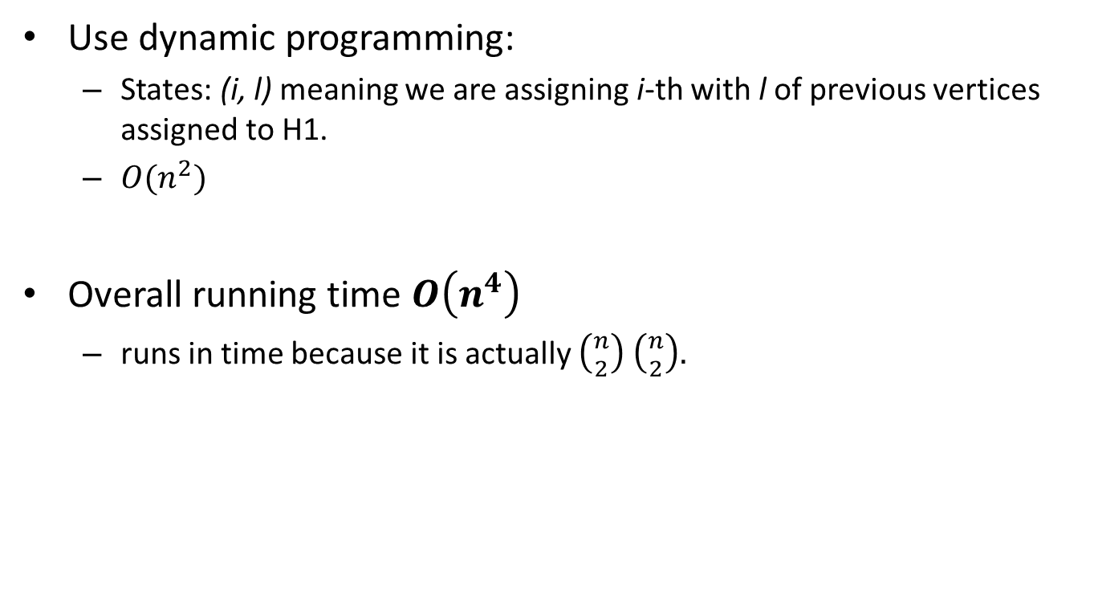
Problem E: Hubs
Use dynamic programming:
  States: (i, l) meaning we are assigning i-th with l of previous vertices assigned to H1.
  $O(n^{2})$
Overall running time $O\left(n^{4}\right)$
  runs in time because it is actually $\left({n \atop 2}\right)$ $\left({n \atop 2}\right).$

Slide 15
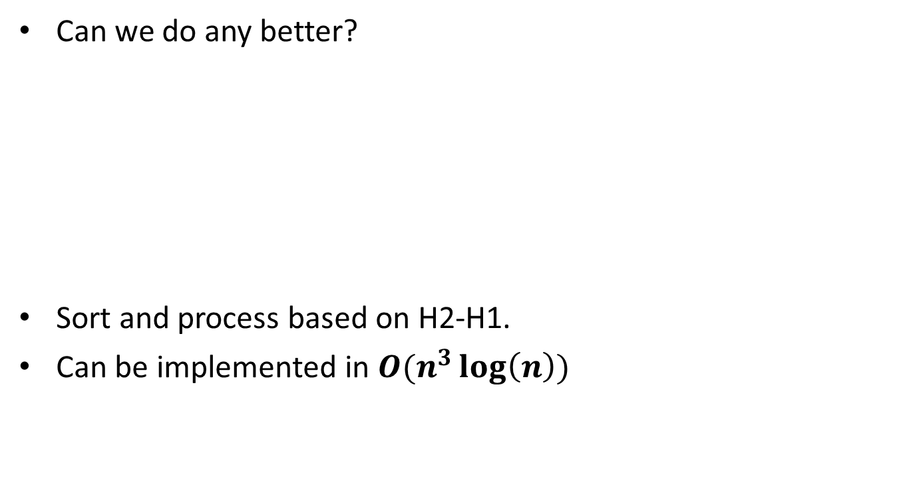
Problem E: Hubs
Can we do any better?
Sort and process based on H2-H1.
Can be implemented in $O(n^{3}\log\left(n\right))$
 | A | B | C | D | E
H1 | 3 | 2 | 6 | 11 | 13
H2 | 10 | 2 | 1 | 5 | 17
H2-H1 | 7 | 0 | -5 | -6 | 4

Slide 16
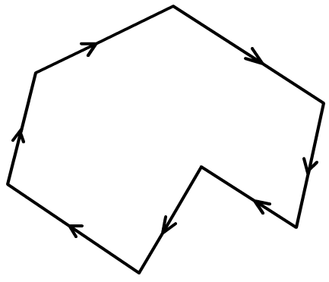
Problem D: Placing a disk inside a polygon
0 correct solutions!
Part 1: check polygon convexity:
Check outer product of every two consecutive vectors
  All positive or all negative

Slide 17
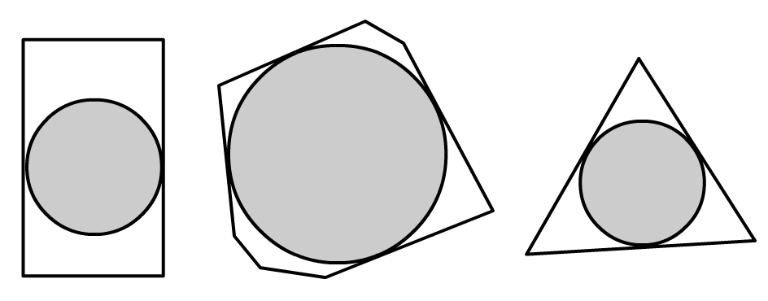
Problem D: Placing a disk inside a polygon
Part 2: largest circle enclosed in convex polygon
Binary search over r, radius of the circle
  Check if a circle of radius r can be put inside the polygon

Slide 18
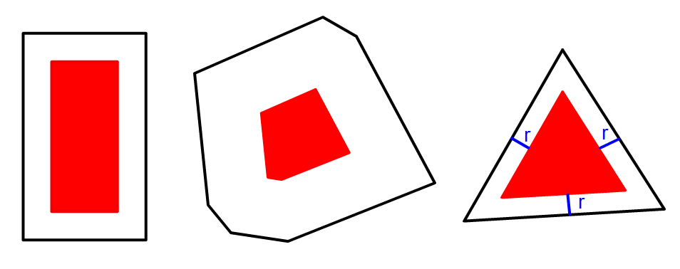
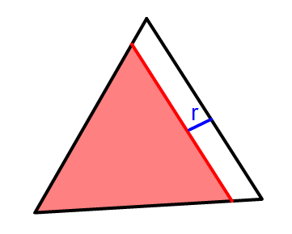
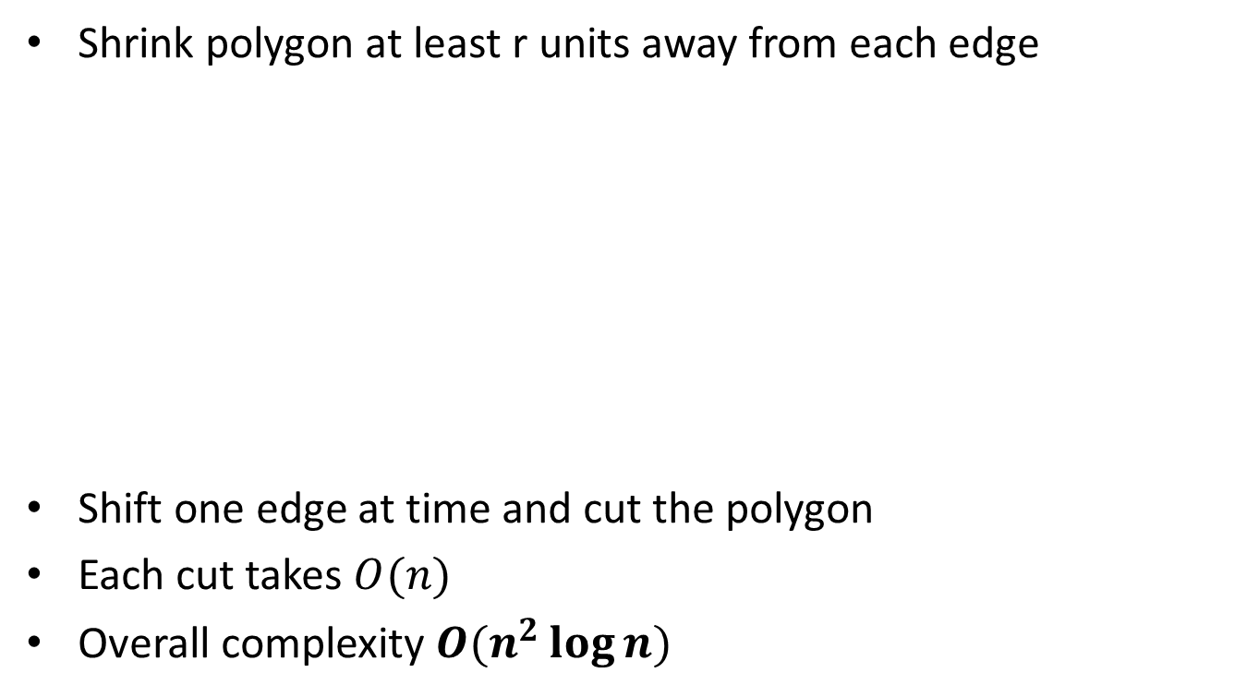
Problem D: Placing a disk inside a polygon
Shrink polygon at least r units away from each edge
Shift one edge at time and cut the polygon
Each cut takes $O(n)$
Overall complexity $O(n^{2}\log{n)}$

Slide 19

The end
Prepared by Pouria Alimirzaei

